Slide 1
Fundamental Sampling Distributions and Data Descriptions: Random Sampling, Sampling Distribution of Means and Variance

Slide 2
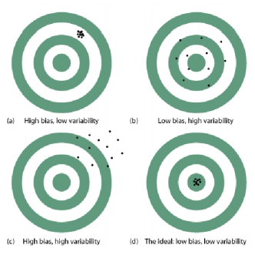
Random Sampling
The basic idea of the statistical inference is that we are allowed to draw inferences or conclusions about a population based on the statistics computed from the sample data so that we could infer something about the parameters and obtain more information about the population. Thus we must make sure that the samples must be good representatives of the population and pay attention on the sampling bias and variability to ensure the validity of statistical inference

Slide 3
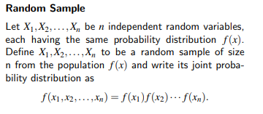
Bias
Any sampling procedure that produces inferences that consistently overestimate or consistently underestimate some characteristic of the population is said to be biased. To eliminate any possibility of bias in the sampling procedure, it is desirable to choose a random sample in the sense that the observations are made independently and at random.

Slide 4
Importance
Sampling distributions are important for inferential statistics. In practice, one will collect sample data and, from these data, estimate parameters of the population distribution. Thus, knowledge of the sampling distribution can be very useful in making inferences about the overall population.

Slide 5
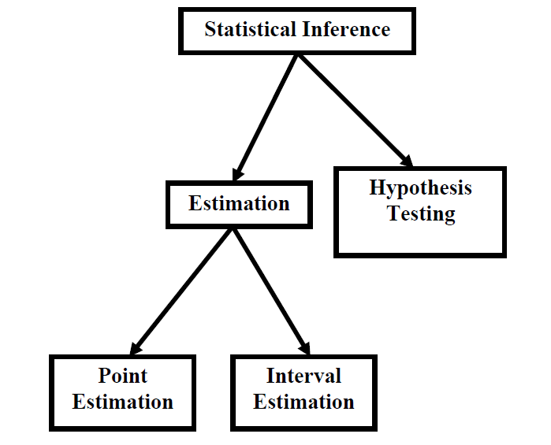
INFERENTIAL STATISTICS
That branch of Statistics which enables us to draw conclusions or inferences about various phenomena on the basis of real data collected on sample basis. In this regard, the first point to be noted is that statistical inference can be divided into two main branches --- estimation, and hypothesis-testing. Estimation itself can be further divided into two branches --- point estimation, and interval estimation
The second important point is that the concept of sampling distributions forms the basis for both estimation and hypothesis-testing,

Slide 6
A point estimate is a single value estimate of a parameter. For instance, a sample mean is a point estimate of a population mean. An interval estimate gives you a range of values where the parameter is expected to lie. A confidence interval is the most common type of interval estimate.

Slide 7
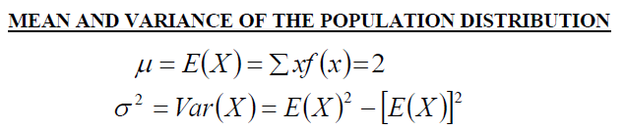
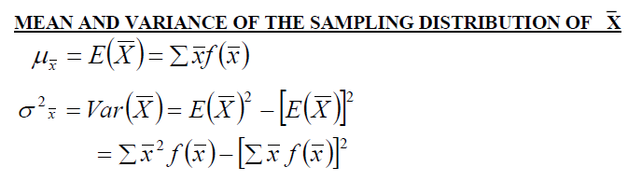
SAMPLING DISTRIBUTION
The probability distribution of any statistic (such as the mean, the standard deviation, the proportion of successes in a sample, etc.) is known as its sampling distribution. In this regard, the first point to be noted is that there are two ways of sampling --- sampling with replacement, and sampling without replacement.
The square root of the variance is the standard deviation, and the standard deviation of a sampling distribution is termed as its standard error.

Slide 8
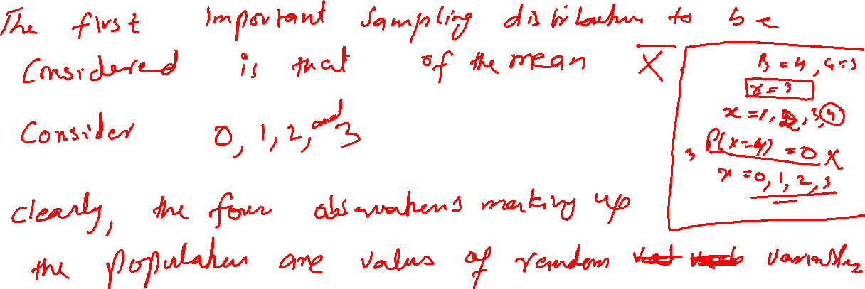
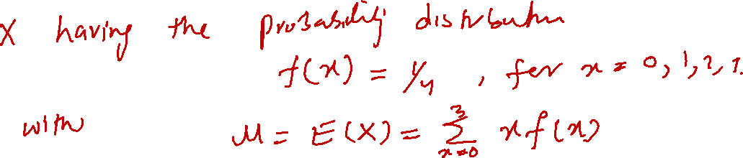

Slide 9
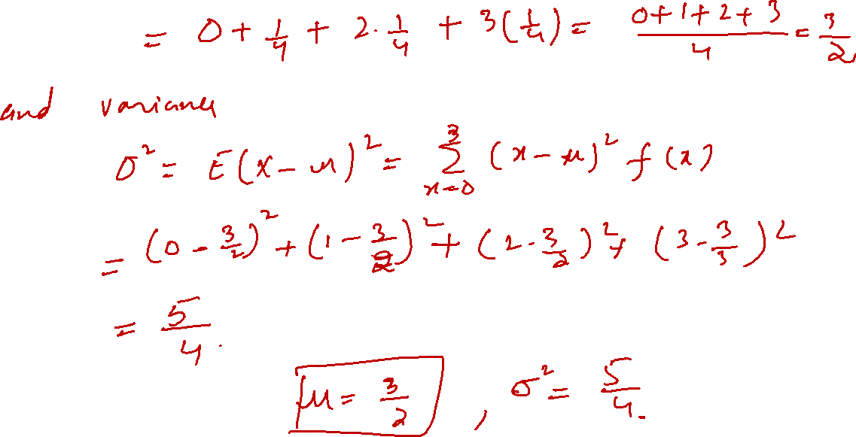

Slide 10
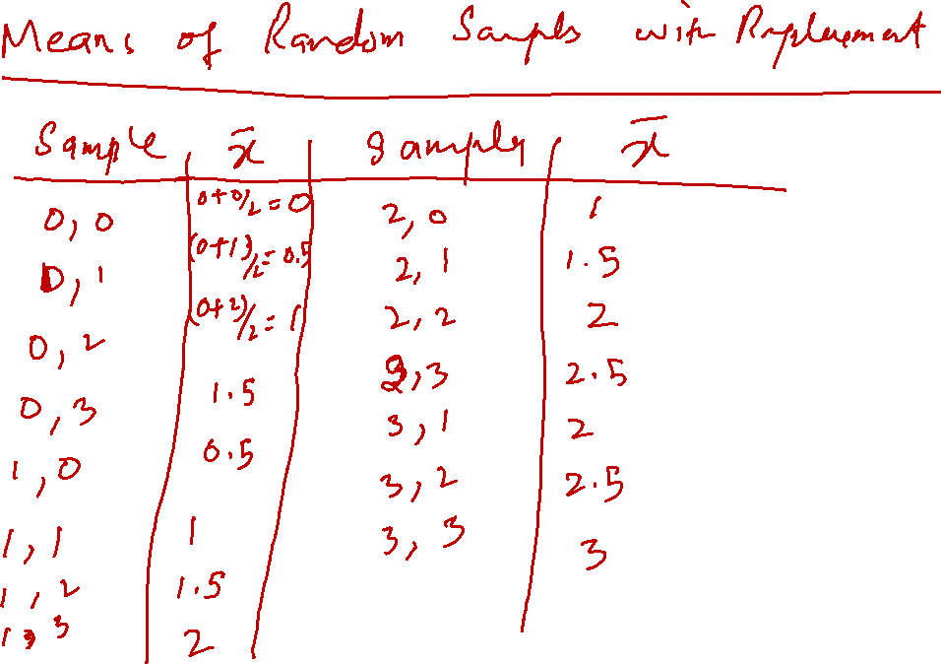


Slide 11
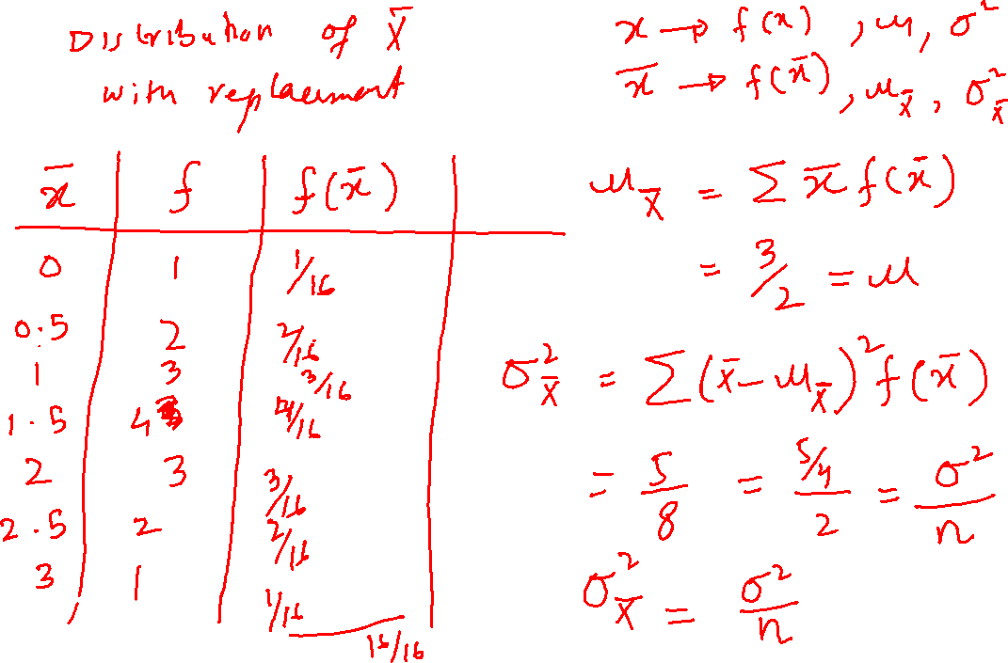

Slide 12
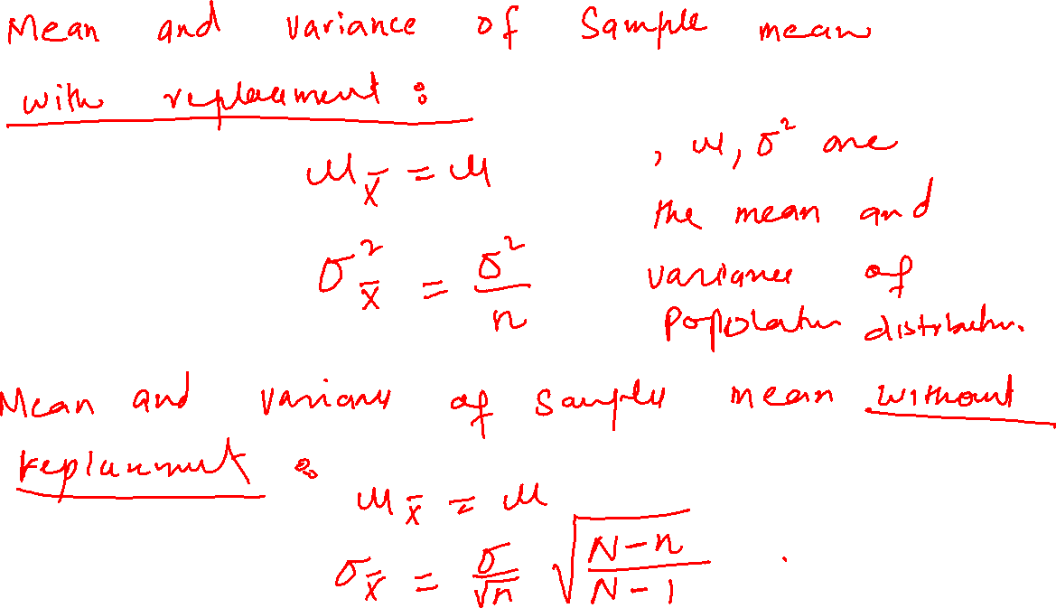

Slide 13
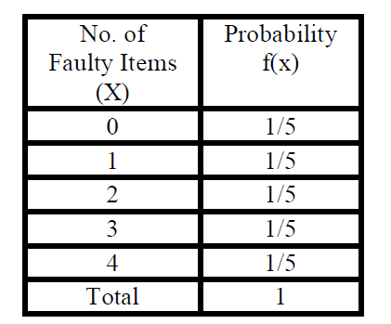
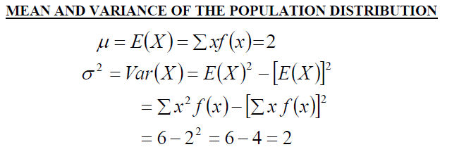
EXAMPLE
In order to compute the mean and standard deviation of this probability distribution, we carry out the following computations,

Slide 14
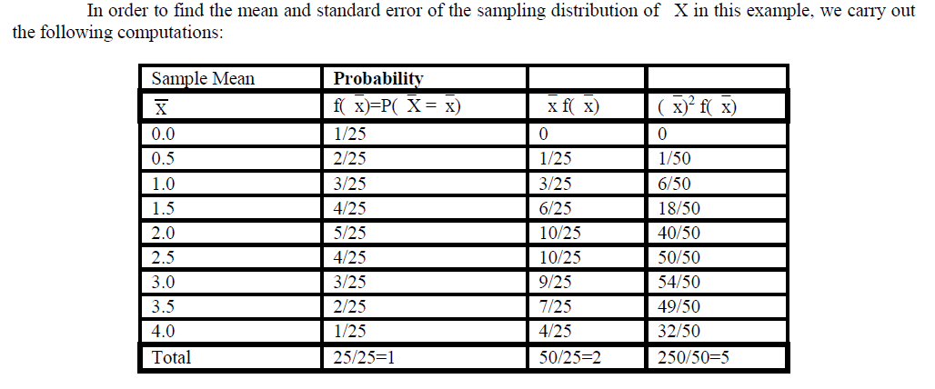

Slide 15
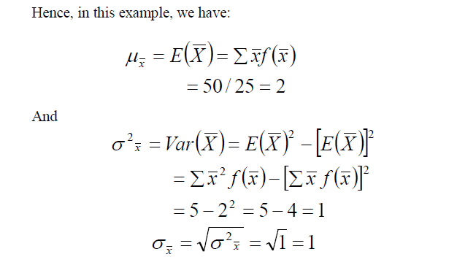

Slide 16
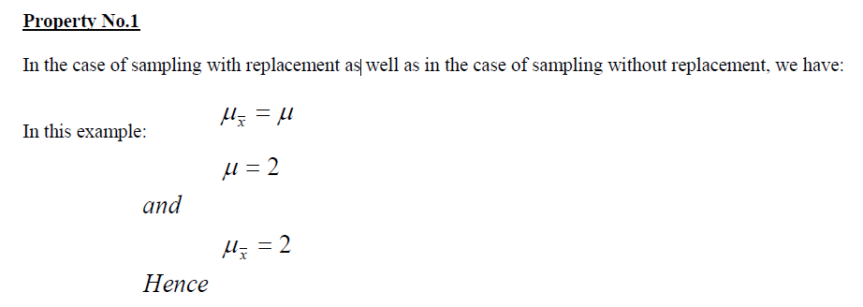


Slide 17

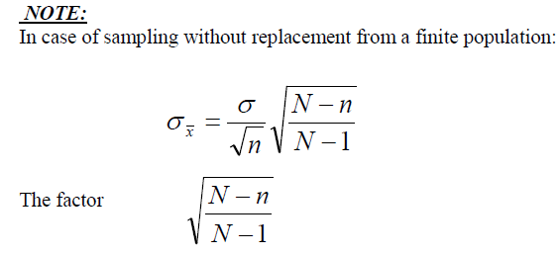
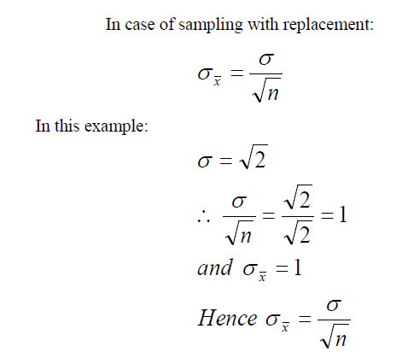
is known as the finite population correction (fpc).

Slide 18
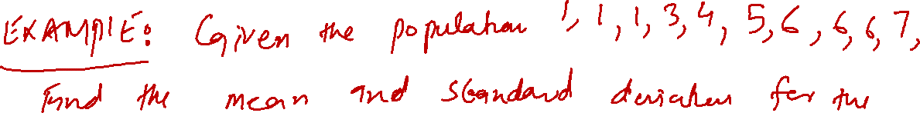
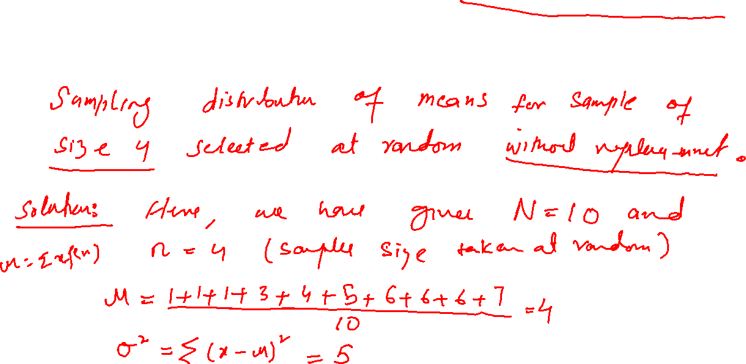

Slide 19
